Slide 1
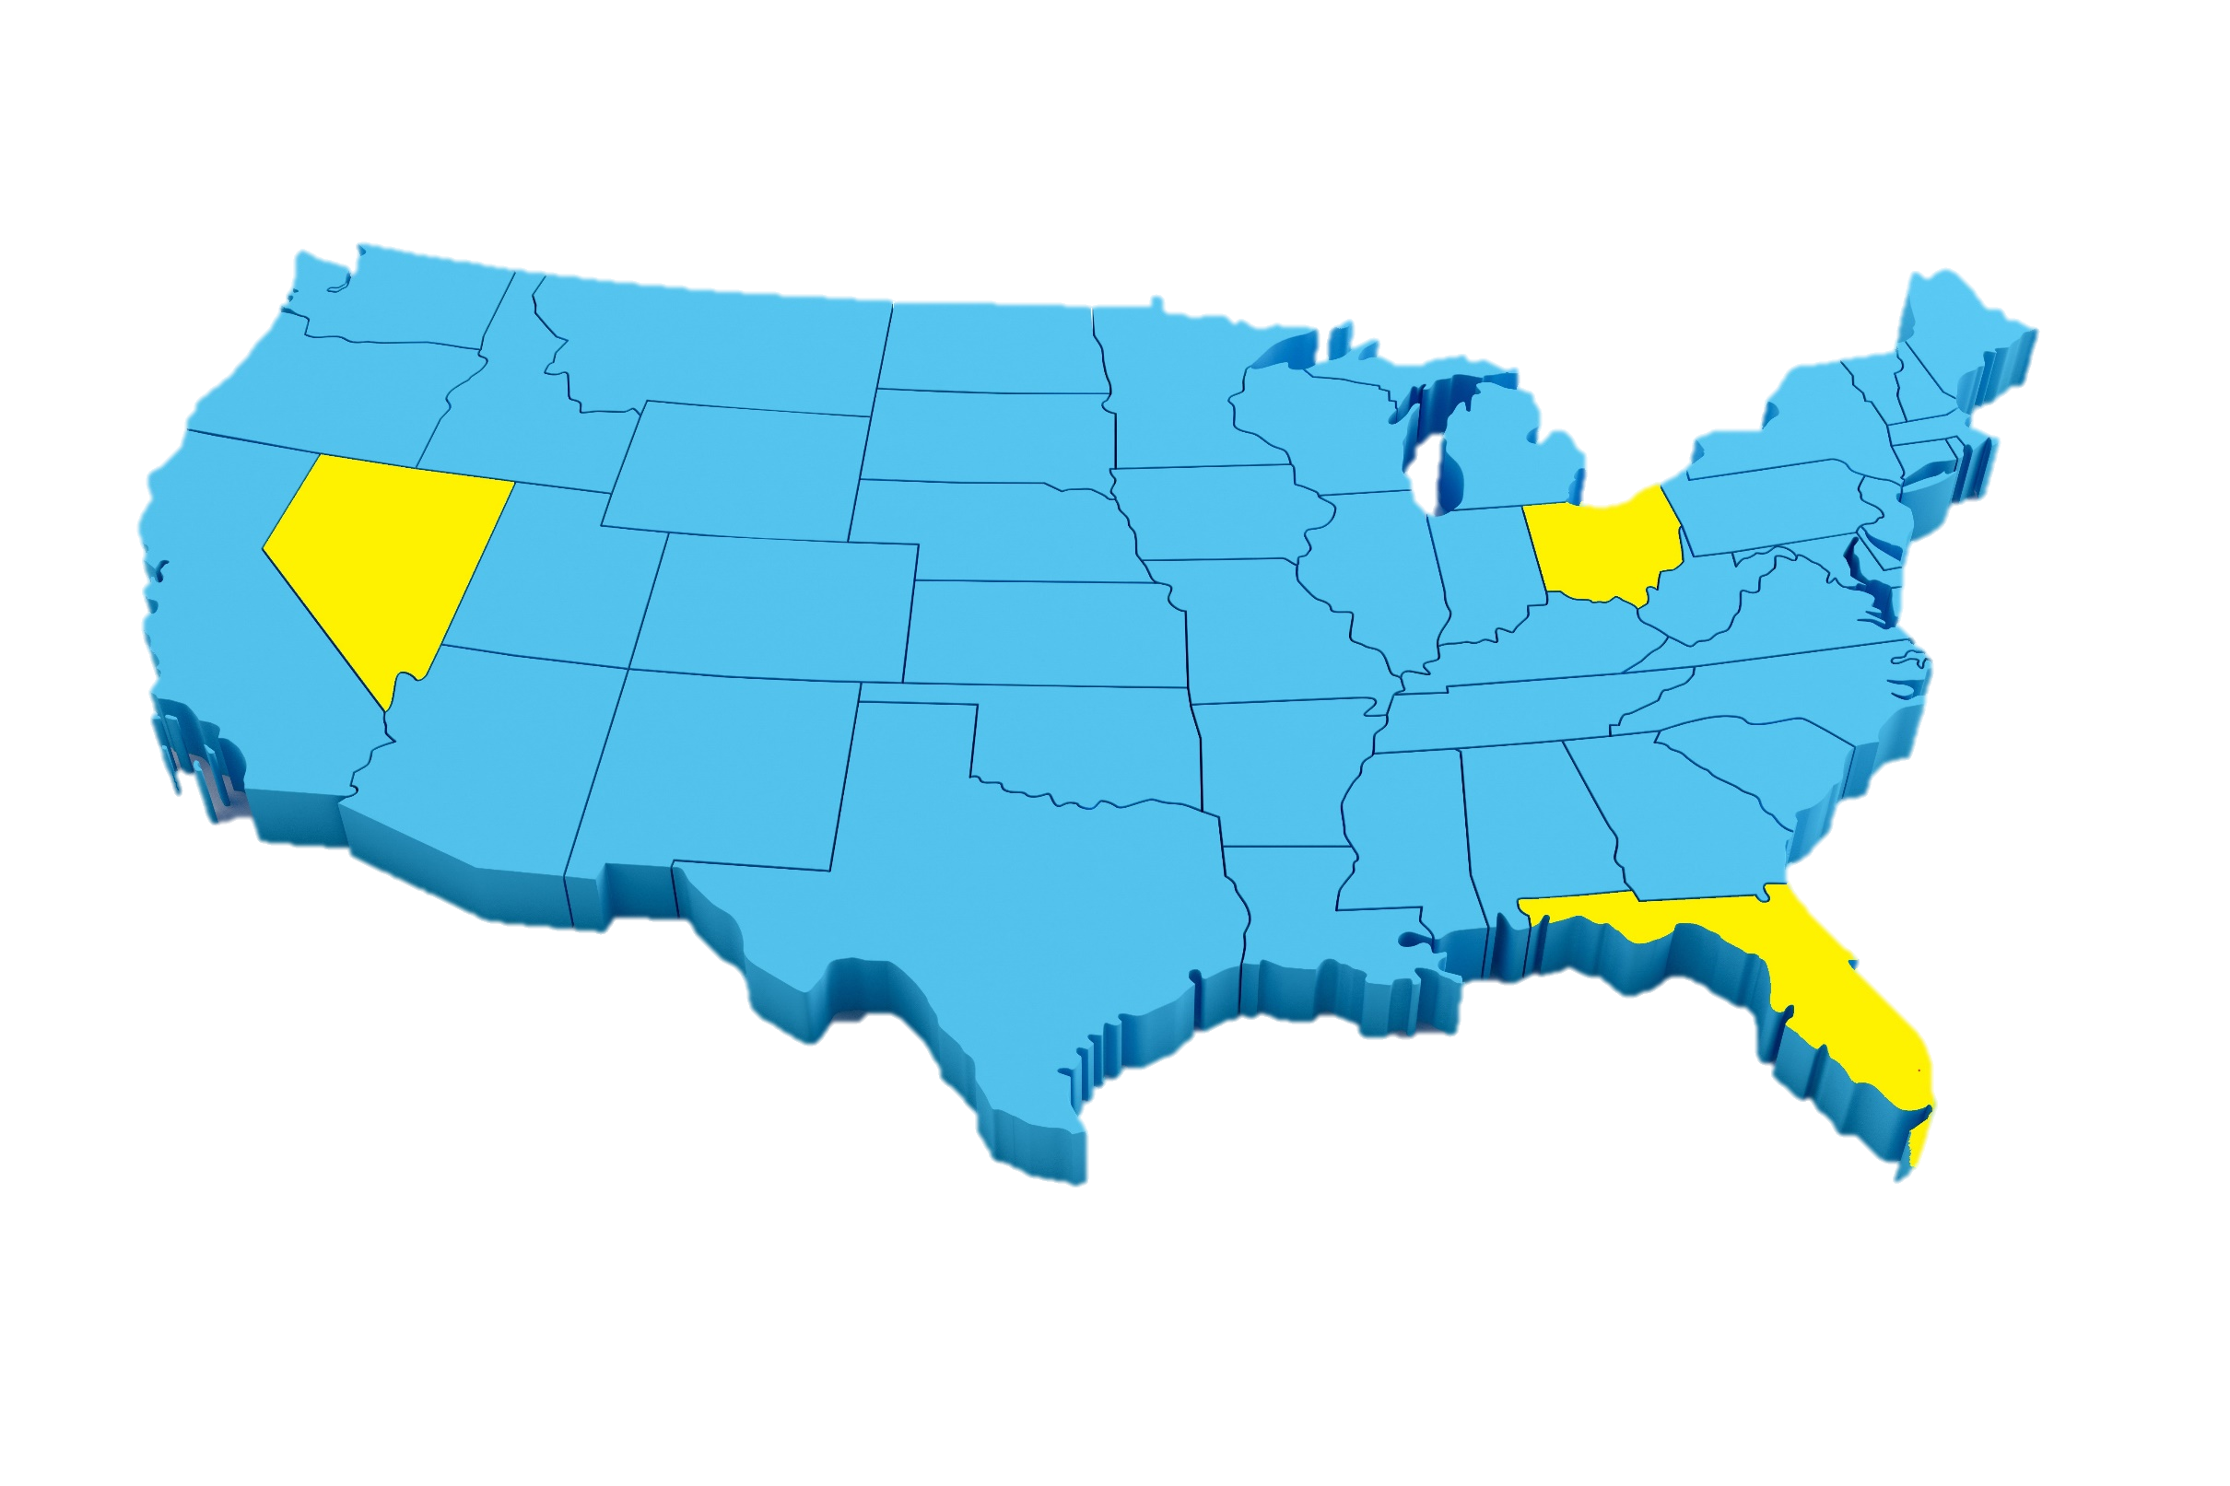

Cincinnati
Columbus
Cleveland
Nevada
Ohio
Florida
Las Vegas
Miami

Slide 2
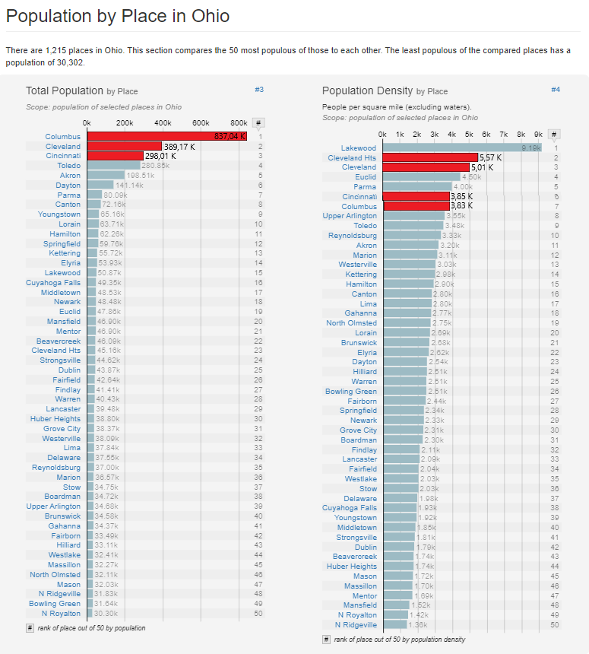
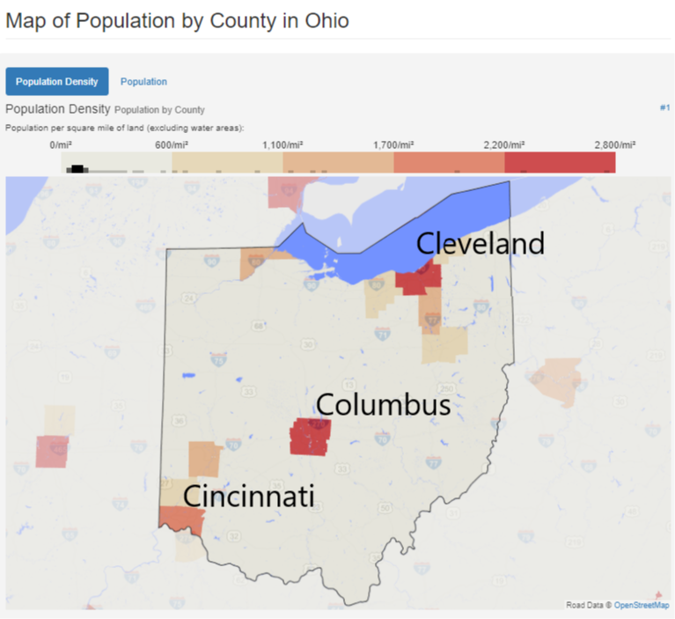
Ohio
Cincinnati
Columbus
Cleveland
Nevada
Ohio
Florida
Las Vegas
Miami

Slide 3
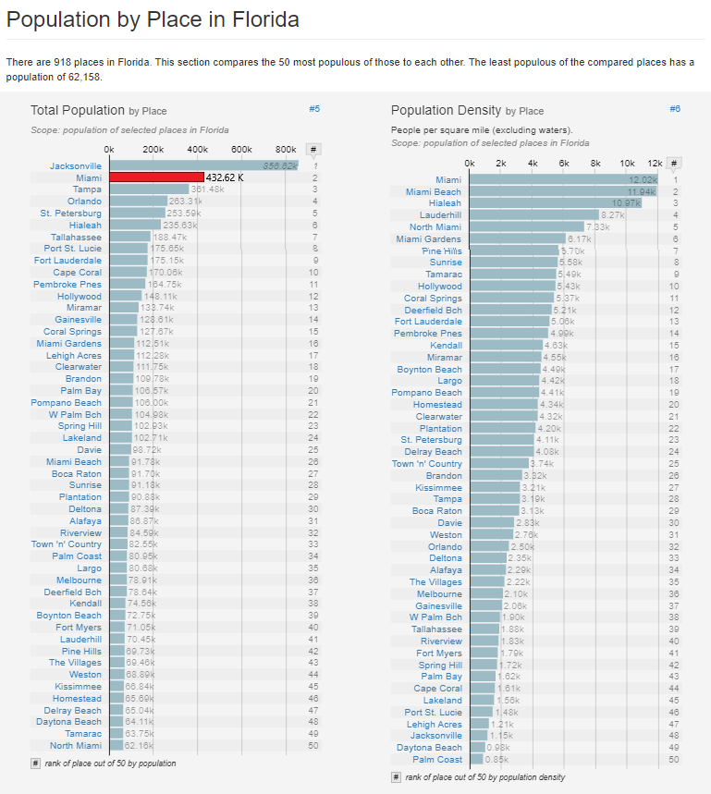
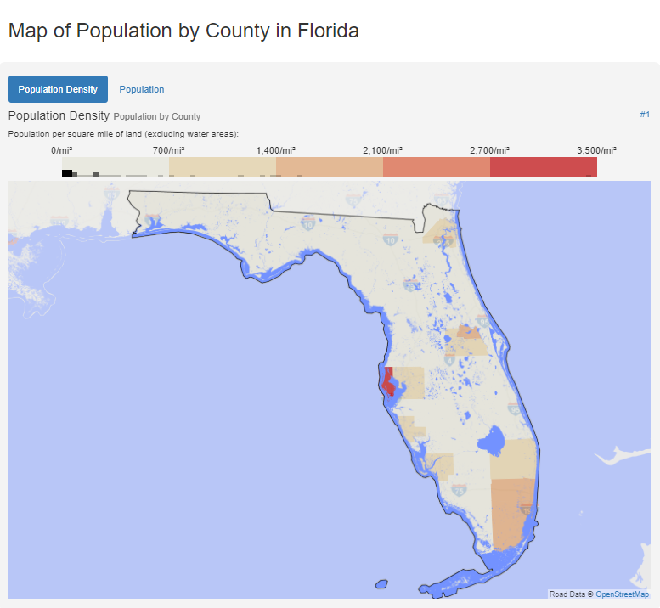
Florida
Cincinnati
Columbus
Cleveland
Nevada
Ohio
Florida
Las Vegas
Miami

Slide 4
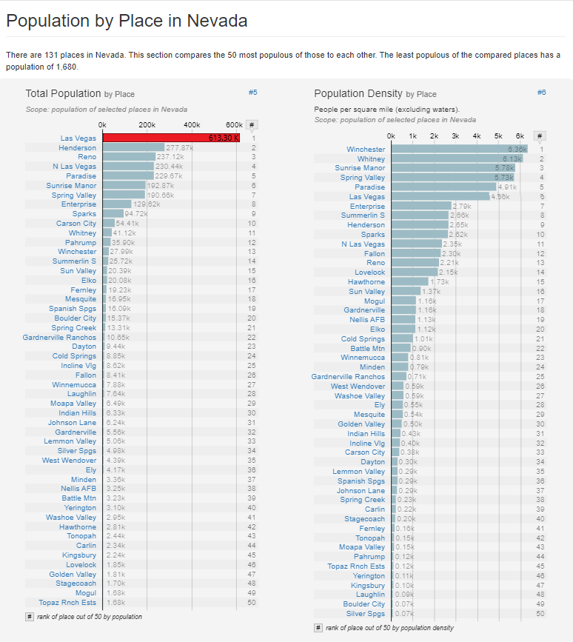
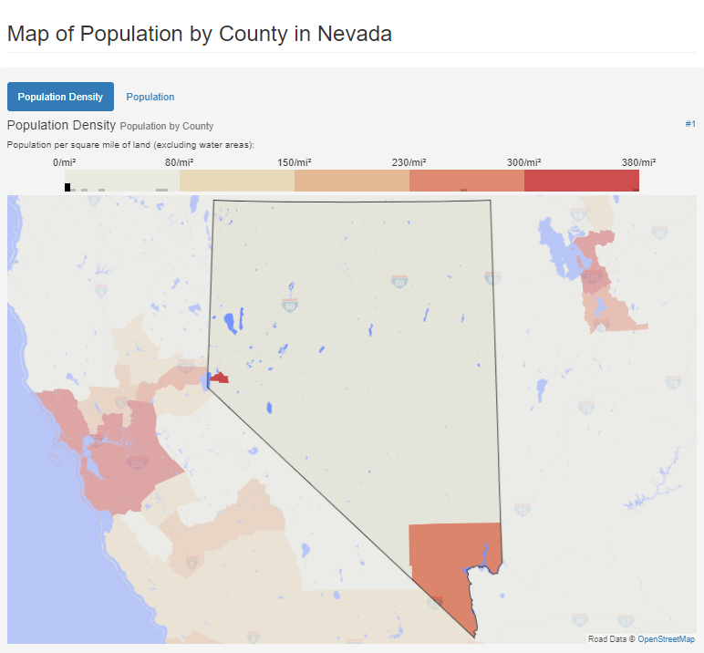
Nevada
Cincinnati
Columbus
Cleveland
Nevada
Ohio
Florida
Las Vegas
Miami

Slide 5
Cincinnati
Columbus
Cleveland
Nevada
Ohio
Florida
Las Vegas
Miami

Slide 6
Cincinnati
Columbus
Cleveland
Nevada
Ohio
Florida
Las Vegas
Miami

Slide 7
Cincinnati
Columbus
Cleveland
Nevada
Ohio
Florida
Las Vegas
Miami

Slide 8
Cincinnati
Columbus
Cleveland
Nevada
Ohio
Florida
Las Vegas
Miami

Slide 9
Cincinnati
Columbus
Cleveland
Nevada
Ohio
Florida
Las Vegas
Miami

Slide 10
Cincinnati
Columbus
Cleveland
Nevada
Ohio
Florida
Las Vegas
Miami

